Slide 1
LOW LATENCY SCHEDULING FOR DELAY SENSITIVE APPLICATIONS
Team Members:
Gnanavel K M - 2018105528
Gowtham P - 2018105531
Yokesh N - 2018105623
Aravinth S - 2018105010
Project Guide : Dr.M.A.Bhagyaveni

Slide 2
OBJECTIVE
The data generated by the IoT devices sent to the cloud for processing the high amount of data.
There is a huge delay due to this, Our idea is to reduce the delay between the IoT devices and cloud services.
So it is very useful in IoT Applications such as healthcare applications, wearables, intelligent transportation systems and smart cities.
Certain delay sensitive applications require low latency , to address this issue we introduce a number of scheduling algorithms.
We compare the benefits of different scheduling algorithms using iFogsim simulator.

Slide 3
INTRODUCTION
In today's world, the internet of things (IoT) is developing rapidly.
Wireless sensor network (WSN) as an infrastructure of IoT has limitations
in the processing power, storage, and delay for data transfer to cloud.
Also sending all the data generated by the IoT to the cloud may not be possible due to limited data carrying capacity of the current network infrastructure.
The integration of IoT with the cloud has some major issues such as latency, bandwidth overuse, real-time response delays, protection, and privacy.

Slide 4
INTRODUCTION (Cont.)
Fog Computing (FC) has been introduced to bring the cloud services closer to the data generating loT devices.
Fog computing is not a replacement for cloud computing, but it reduces the drawbacks of cloud computing, makes it efficient and provides storage and computing services at the edge of the internet.
FC as an extension of cloud to the edge of the network reduces latency and traffic thus, it is very useful in loT applications.
ifogsim is a standard simulation tool kit for fog computing.
We compare the benefits of different scheduling algorithms using ifogsim simulator.

Slide 5
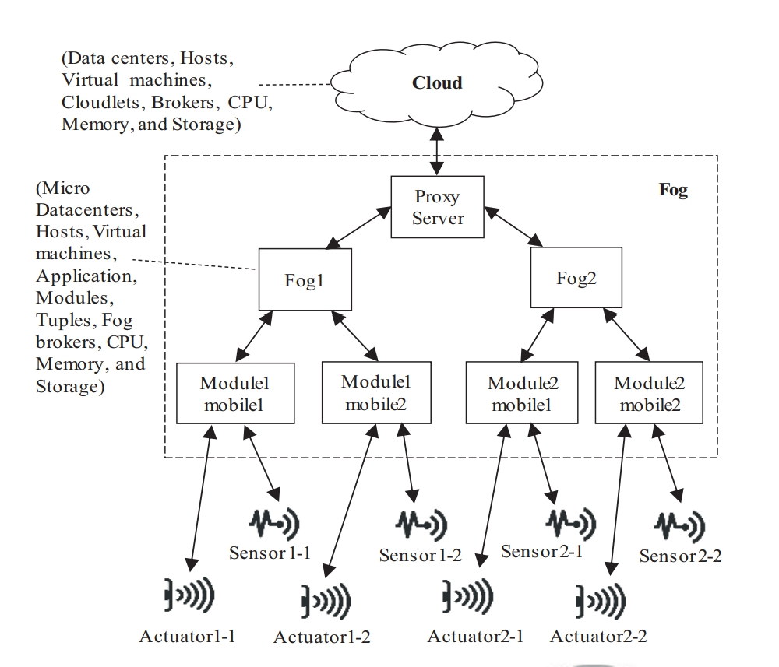
ARCHITECTURE OF FOG COMPUTING

Slide 6
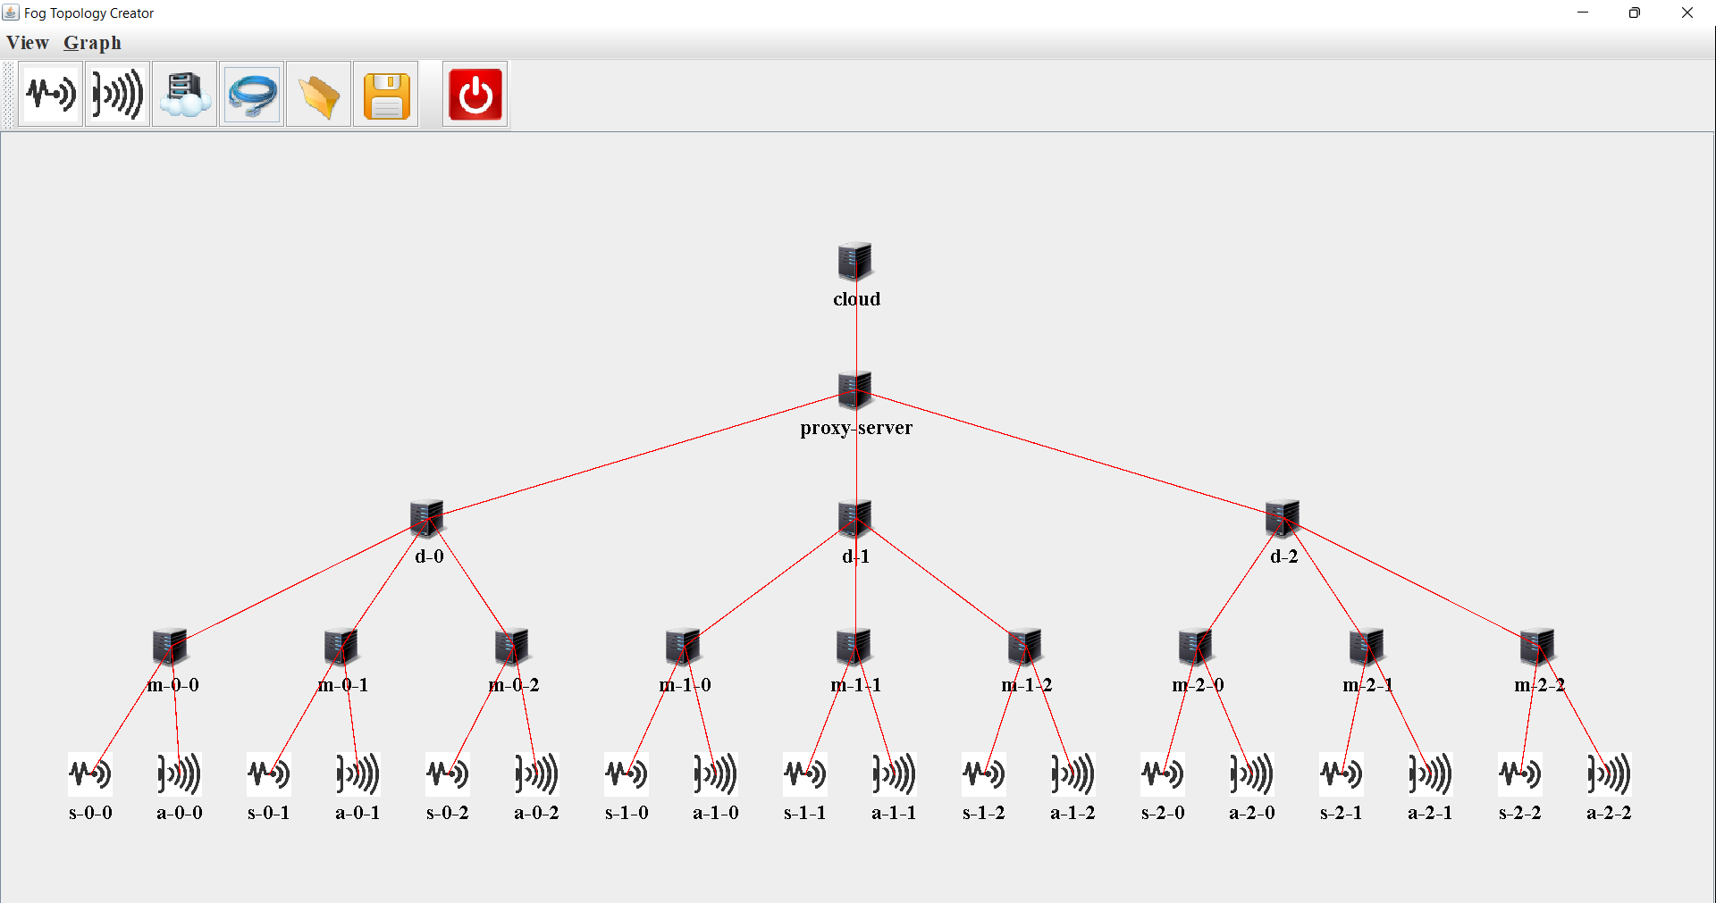
ARCHITECTURE DESIGNED USING GUI

Slide 7
WORK DONE
For First Review :
Architecture of the total network is designed.
Number of fog devices, sensors, actuators are inserted as per our requirement.
Application is created based on the type of IoT service required, and divided into several modules.
The modules are mapped to the fog devices.
First come First serve algorithm is implemented.
For Second Review :
Priority scheduling , Priority based on Threshold value, Knapsack Algorithms are implemented.
Work to be done :
The results of all the above mentioned algorithms (FCFS, Priority, Knapsack) will be compared with each other.

Slide 8
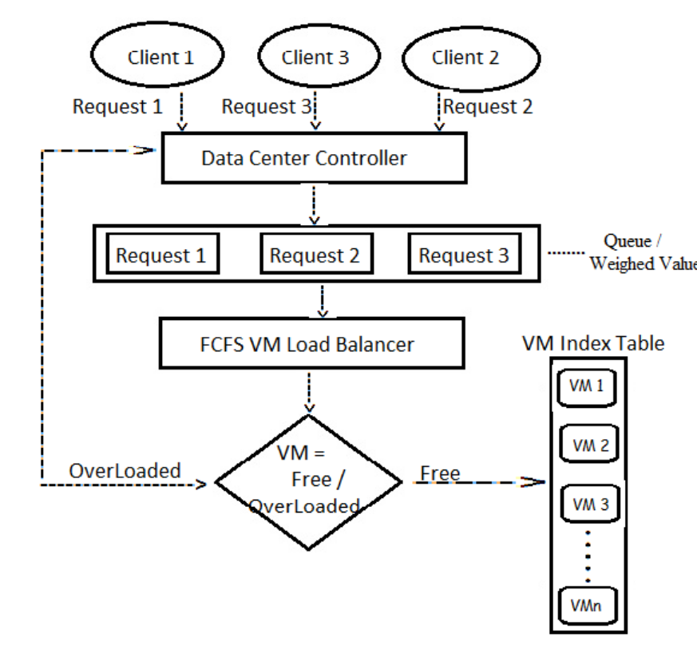
FCFS ALGORITHM

Slide 9
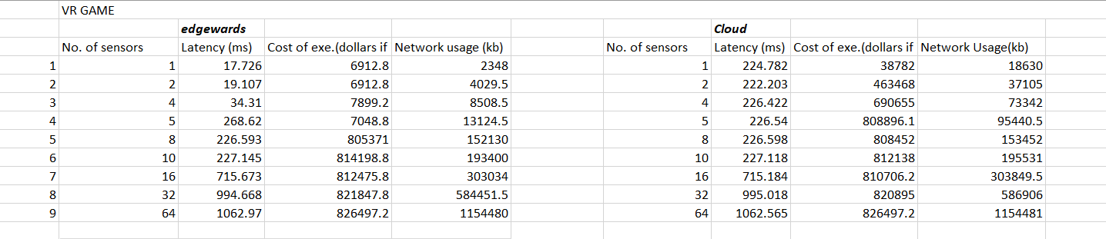
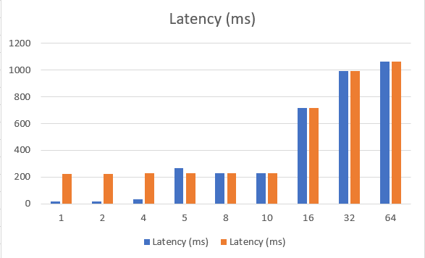
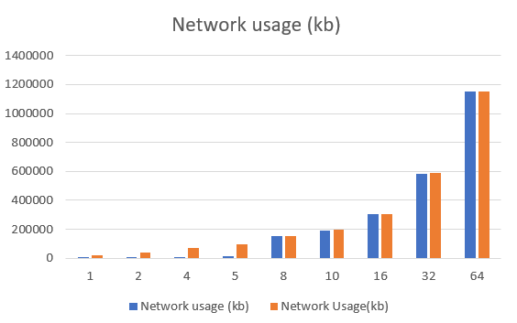
RESULTS

Slide 10
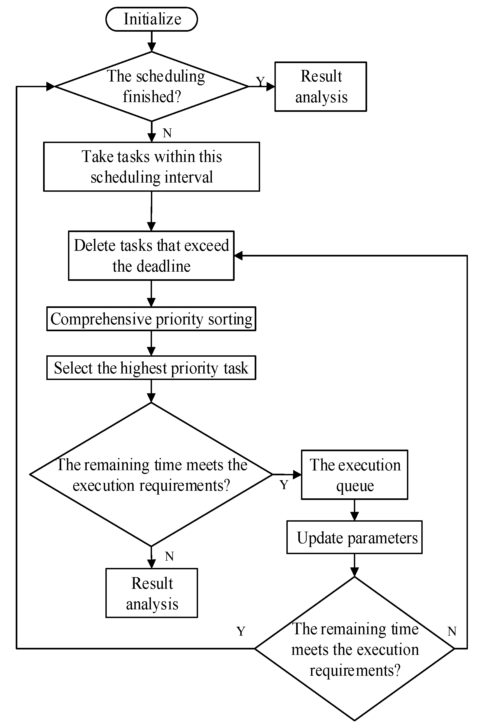
PRIORITY SCHEDULING ALGORITHM

Slide 11
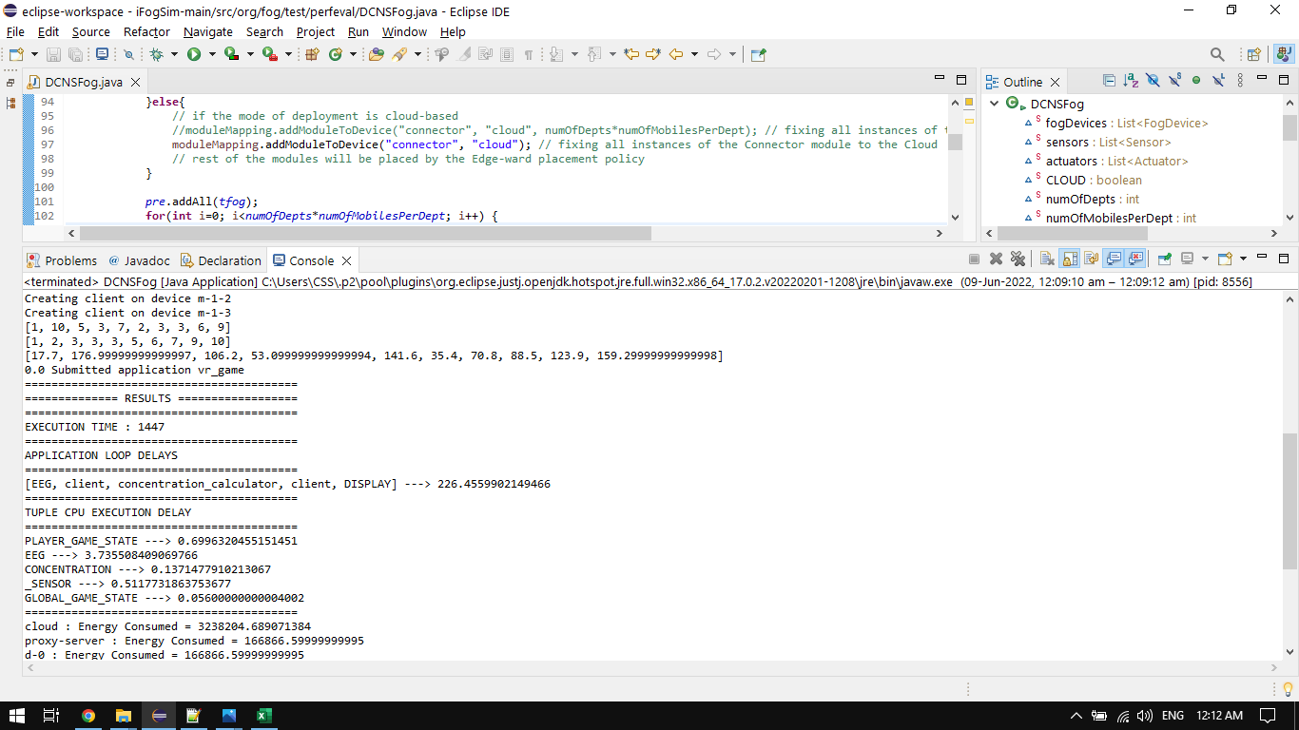
RESULTS

Slide 12
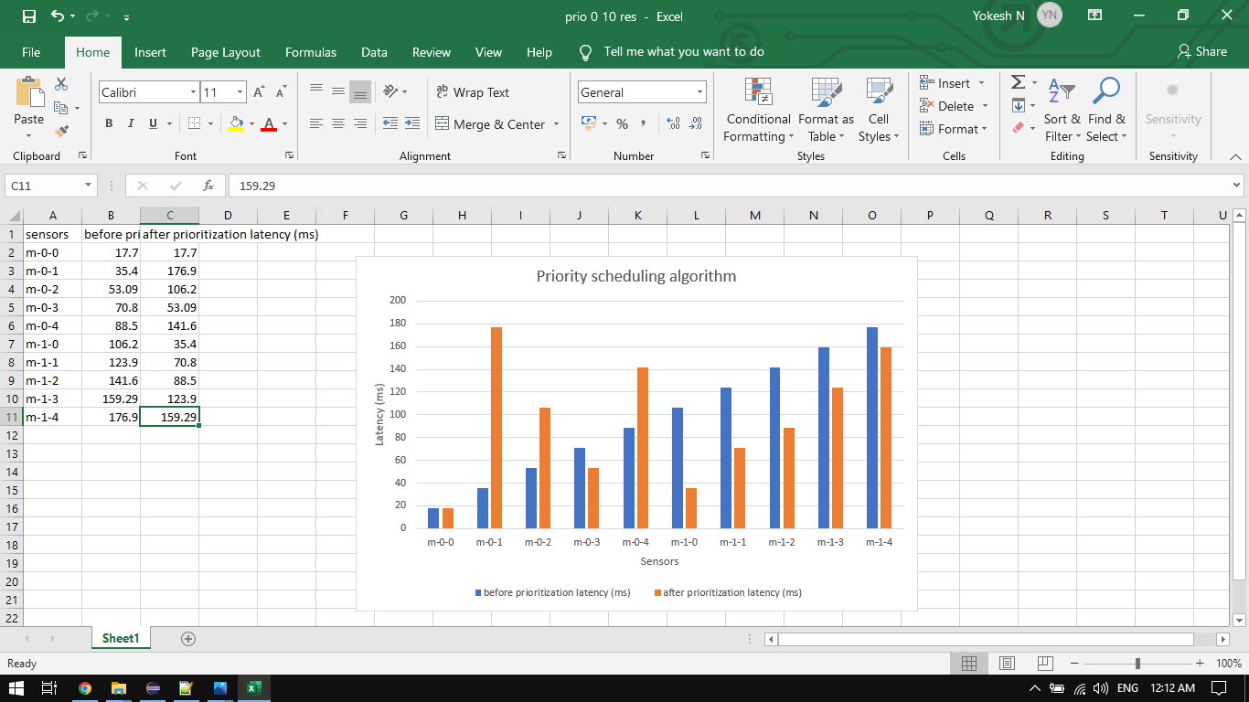
RESULTS

Slide 13
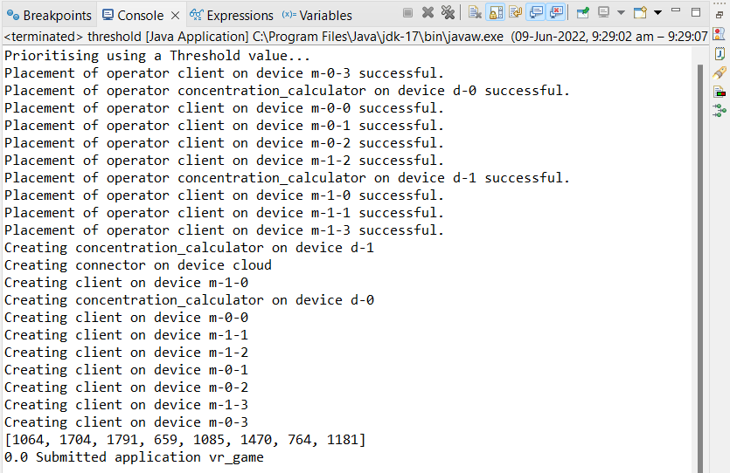
PRIORITY BASED ON THRESHOLD

Slide 14
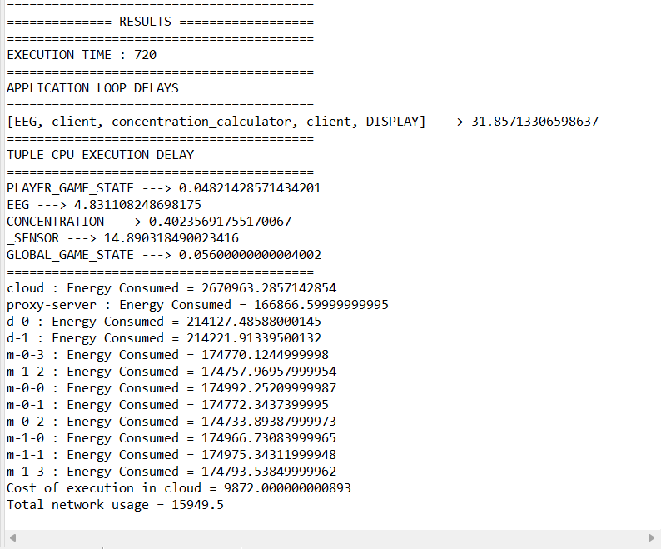
RESULTS

Slide 15
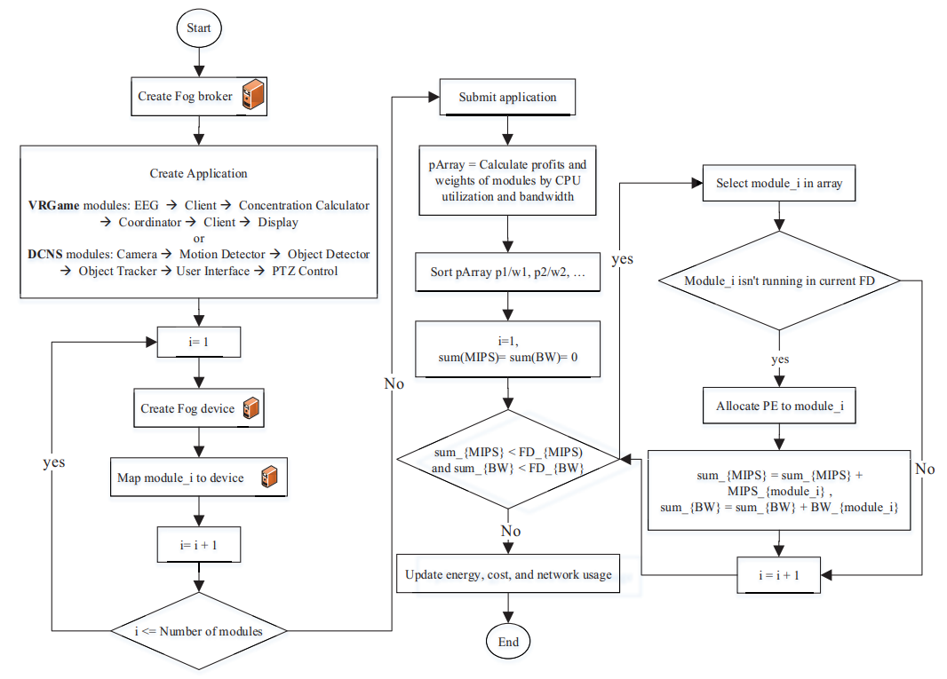
KNAPSACK ALGORITHM

Slide 16
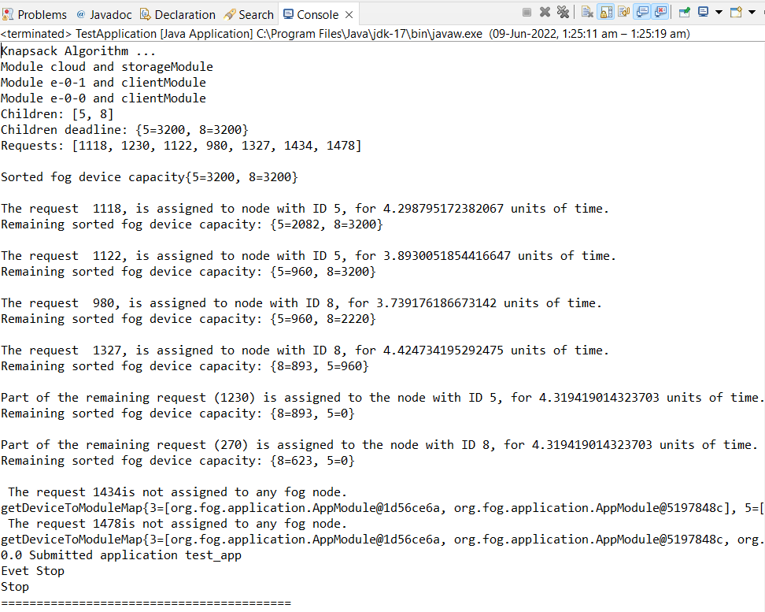
RESULTS

Slide 17
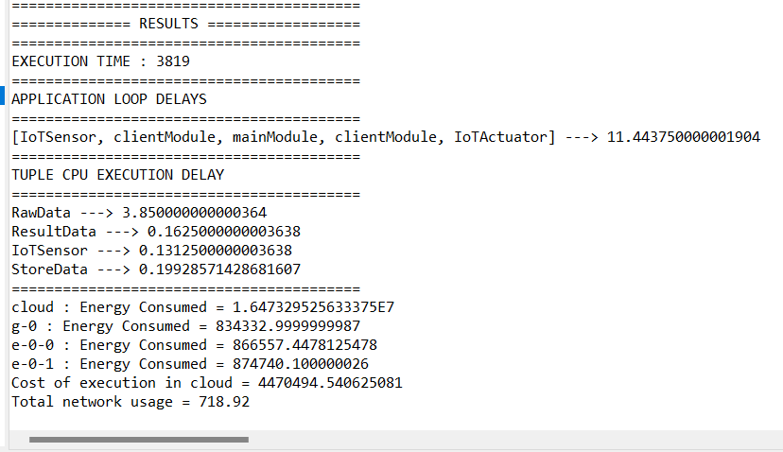
RESULTS

Slide 18
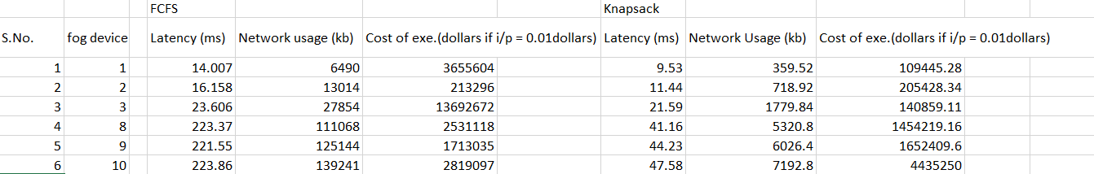
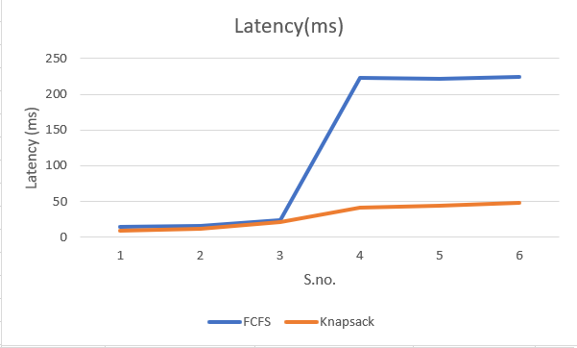
RESULT

Slide 19
REFERENCE
L. F. Bittencourt, J. Diaz-Montes, R. Buyya, O. F. Rana and M. Parashar, "Mobility-Aware Application Scheduling in Fog Computing," in IEEE Cloud Computing, vol. 4, no. 2, pp. 26-35, March-April 2017, doi: 10.1109/MCC.2017.27.
J. X. Liao and X. W. Wu, "Resource Allocation and Task Scheduling Scheme in Priority-Based Hierarchical Edge Computing System," 2020 19th International Symposium on Distributed Computing and Applications for Business Engineering and Science (DCABES), 2020, pp. 46-49, doi: 10.1109/DCABES50732.2020.00021.
Gupta H, Dastjerdi AV, Ghosh SK, Buyya R. ifogsim: toolkit for modeling and simulation of resource management techniques in internet of things, edge and fog computing environments. Software: Practice and Experience 2017; 47(9): 1275-1296. doi: 10.1002/spe.2509

Slide 20
THANK YOU

